Slide 1
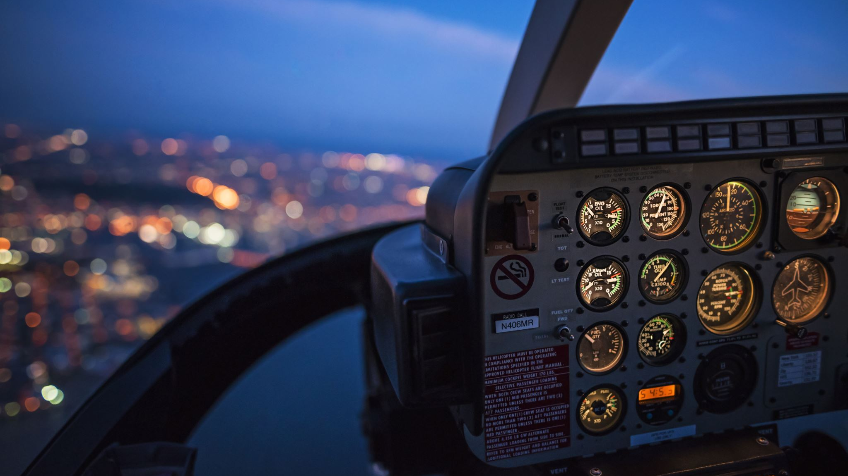
AIRLINE PRICE PREDICTION
Group Name: Data Detectives
Step Presentation #1

Slide 2

Roles For Project
Data Acquisition: Mohamed Maaz Rehan
Data Preprocessing: Comfort
Feature Engineering: Devendra
Model Development: Gaurav Singh and Swetha
Model Evaluation: Janki Zala
Data Warehousing : Gaurav Singh Rawat
Deployment: Fatemi and Urjeet
Dashboard Creation: Tirth and Isha

Slide 3

Content
Gantt Chart
Challenges
Objective
Motive For Choosing this project
Project Lifecycle
Introduction to Dataset
Created a basic dashboard
Explored Several Cloud Platform
Some Info From Dataset
Visuals
End

Slide 4
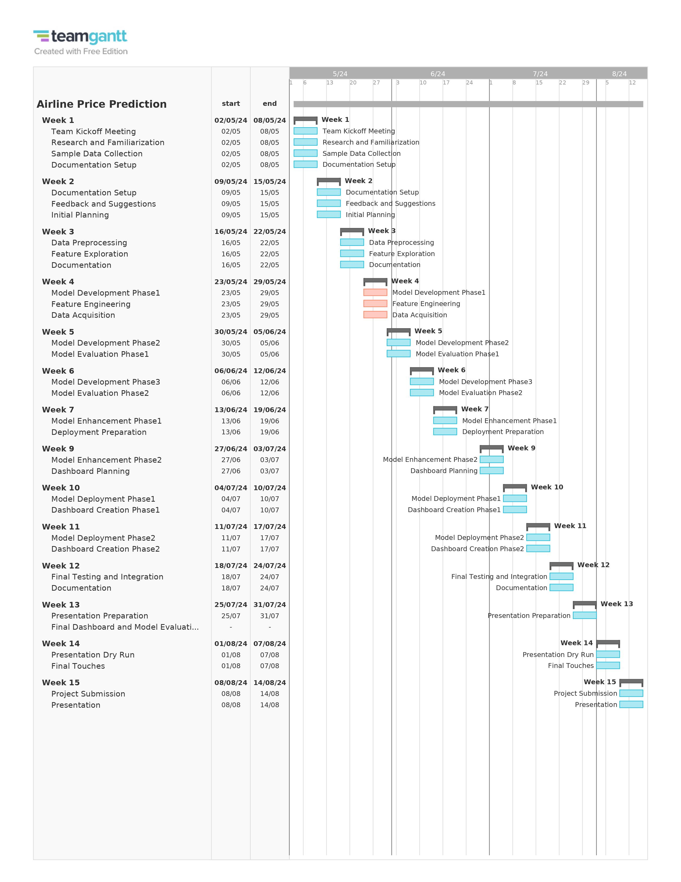
Gantt chart here

Slide 5
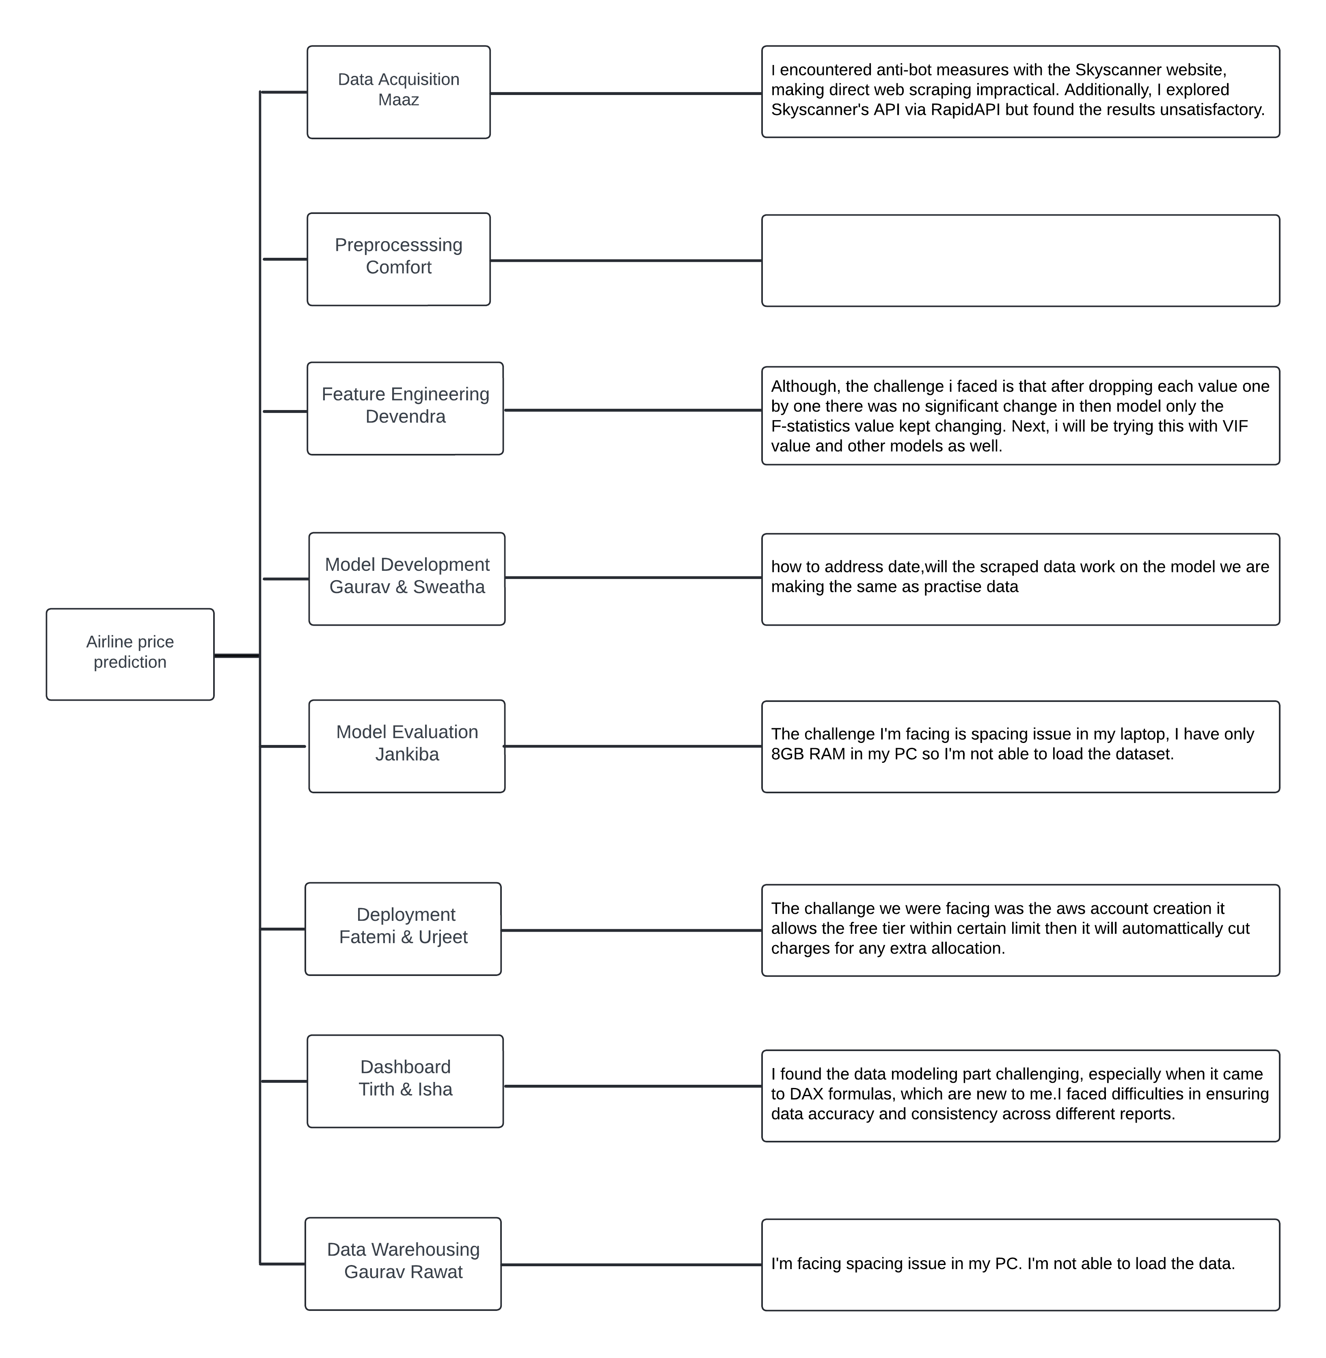
Challenges Faced
These are some challenges we are facing during developing this project.

Slide 6

Objective
The project's goal is to predict future airline ticket prices using past data. We'll analyze historical prices, flight dates, number of stops, and other relevant factors to train our machine learning model.
This will help travelers understand price trends and plan trips at the best times to save money. Our aim is to make travel planning easier and more affordable.

Slide 7

Reason for choosing this project?
We brainstormed several ideas and chose Airline Price Prediction.
It will help classmates find the best ticket prices for trips between Canada and their home countries.
We can improve it with feedback, making it a practical choice.

Slide 8
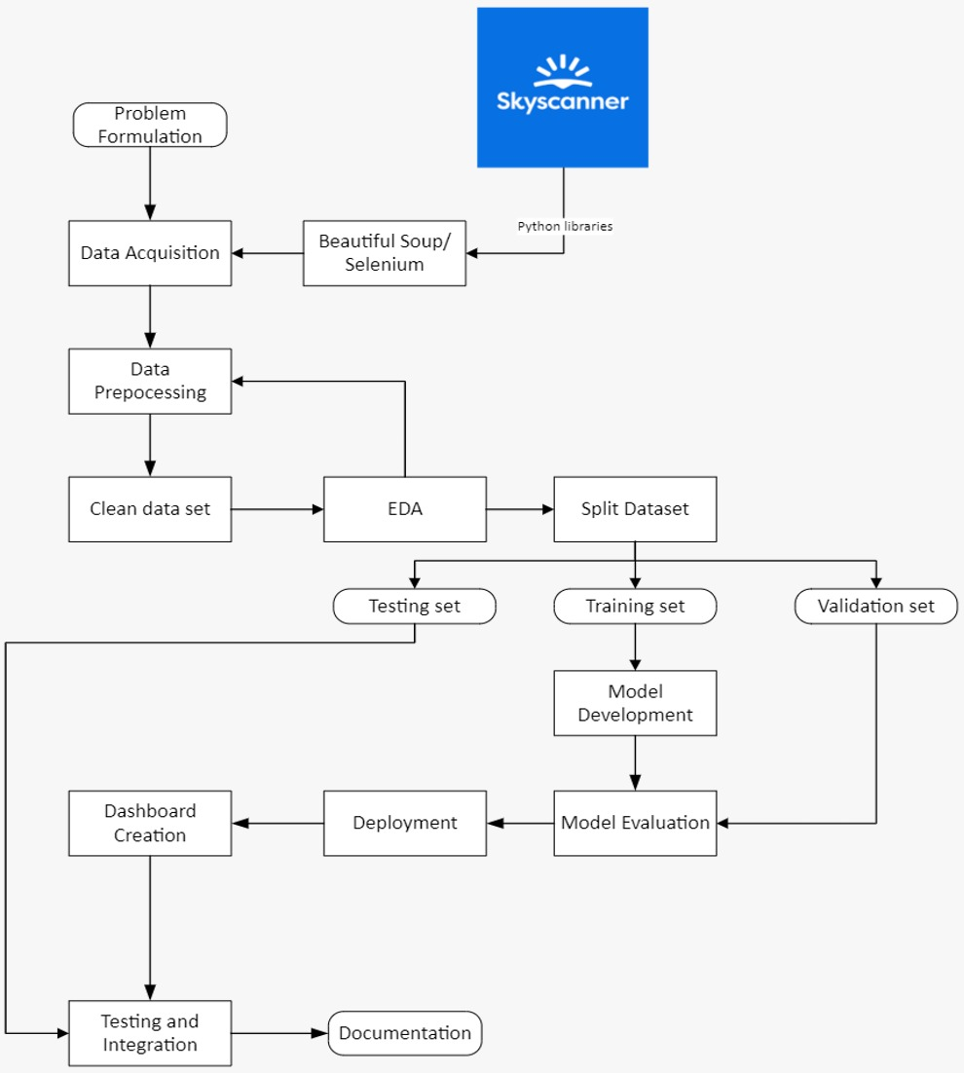
Project Lifecycle.

Slide 9
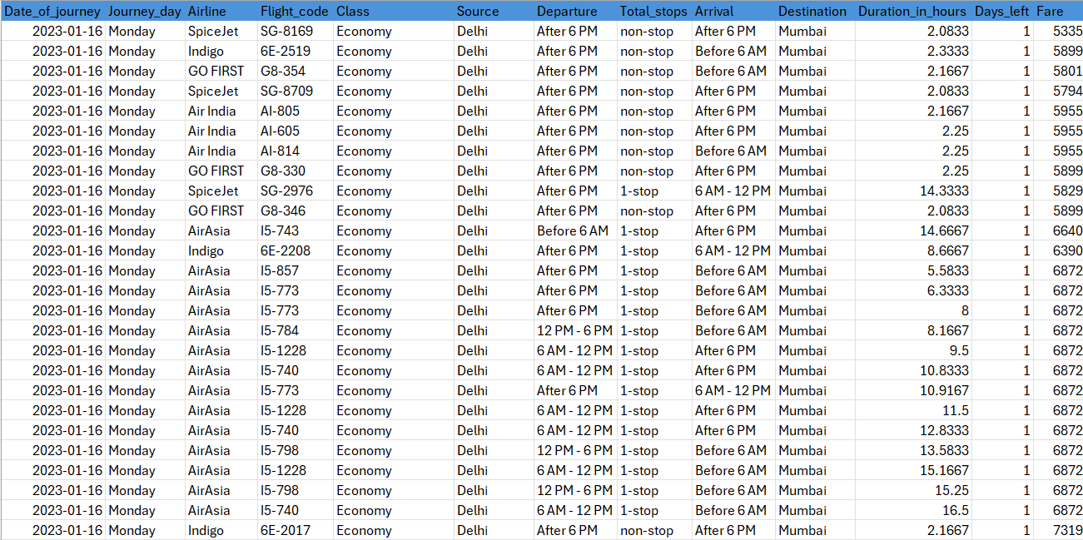
Got our Hands on Learning on a Demo Dataset.
We explored various websites for historical data and chose a comprehensive dataset from Kaggle.
Additionally, we're using Selenium to fetch the latest data from Kayak to keep our model up-to-date.
LET’S DIVE DEEP INTO OUR DATASET

Slide 10
FEATURES

Slide 11
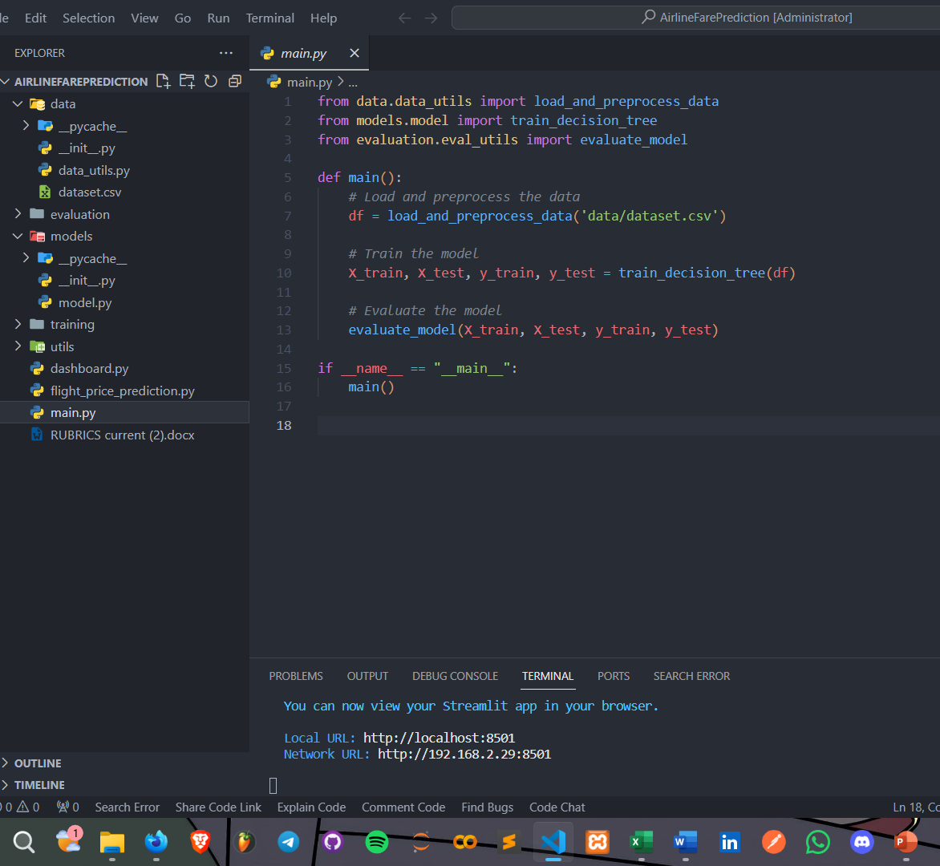
Made Our Code Modular
Modular code in ML enhances readability, reusability, debugging, and collaboration.

Slide 12
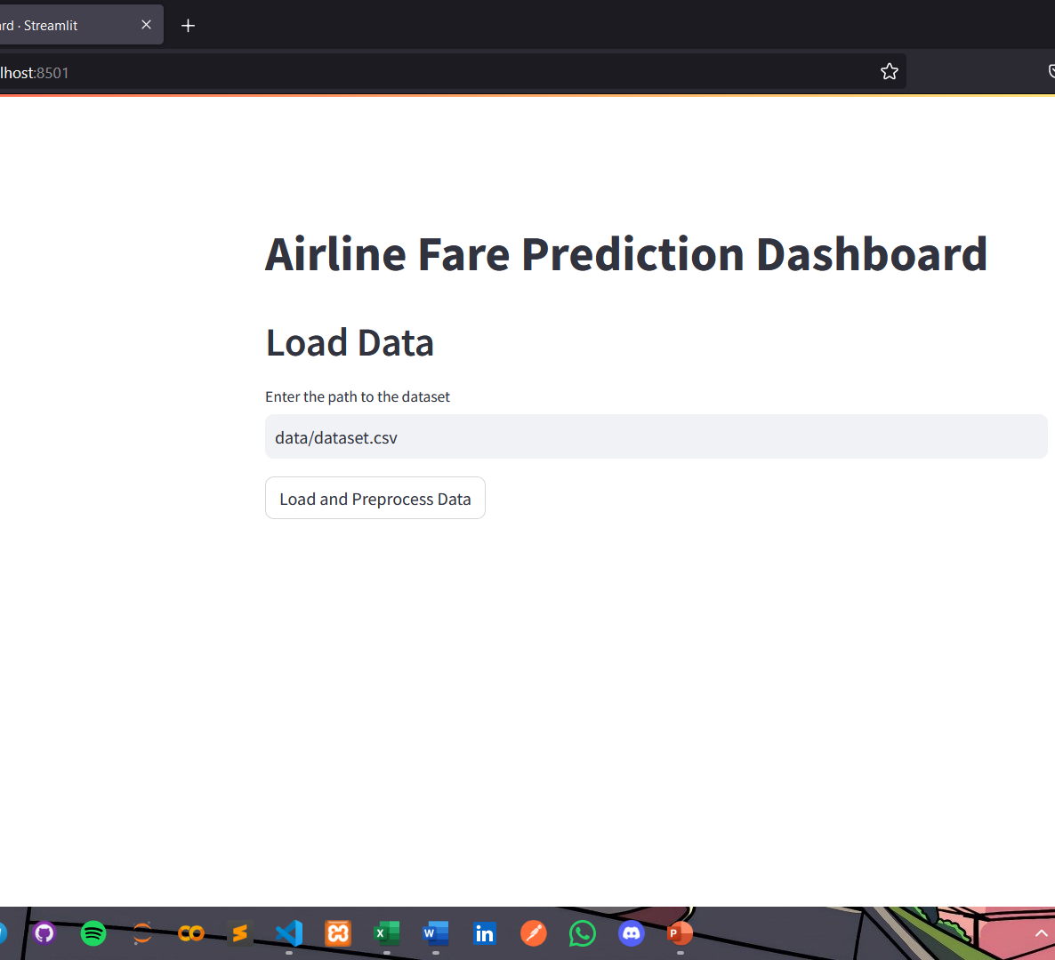
Created a Basic Dashboard
We will keep developing it until the end of the project to boost performance and to get best user interaction.

Slide 13
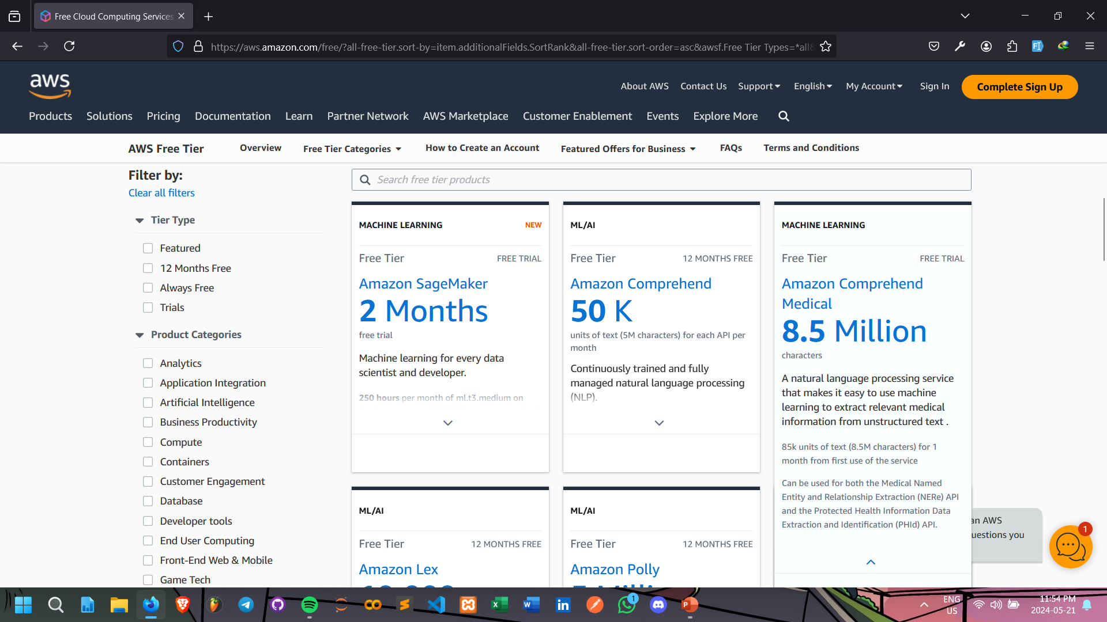
What we Explored so far for deployment?
AWS

Slide 14
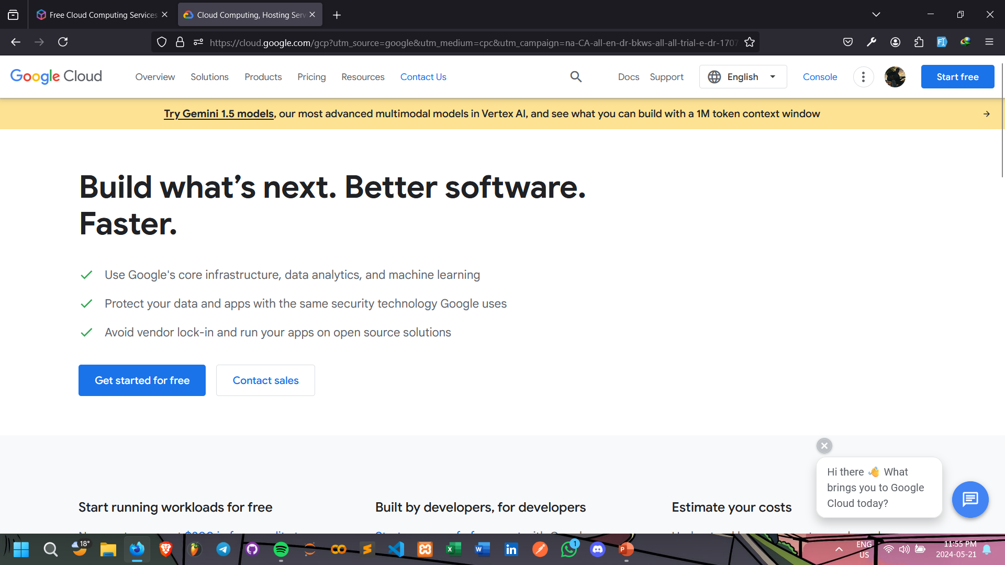
GCP(Google Cloud Platform)

Slide 15
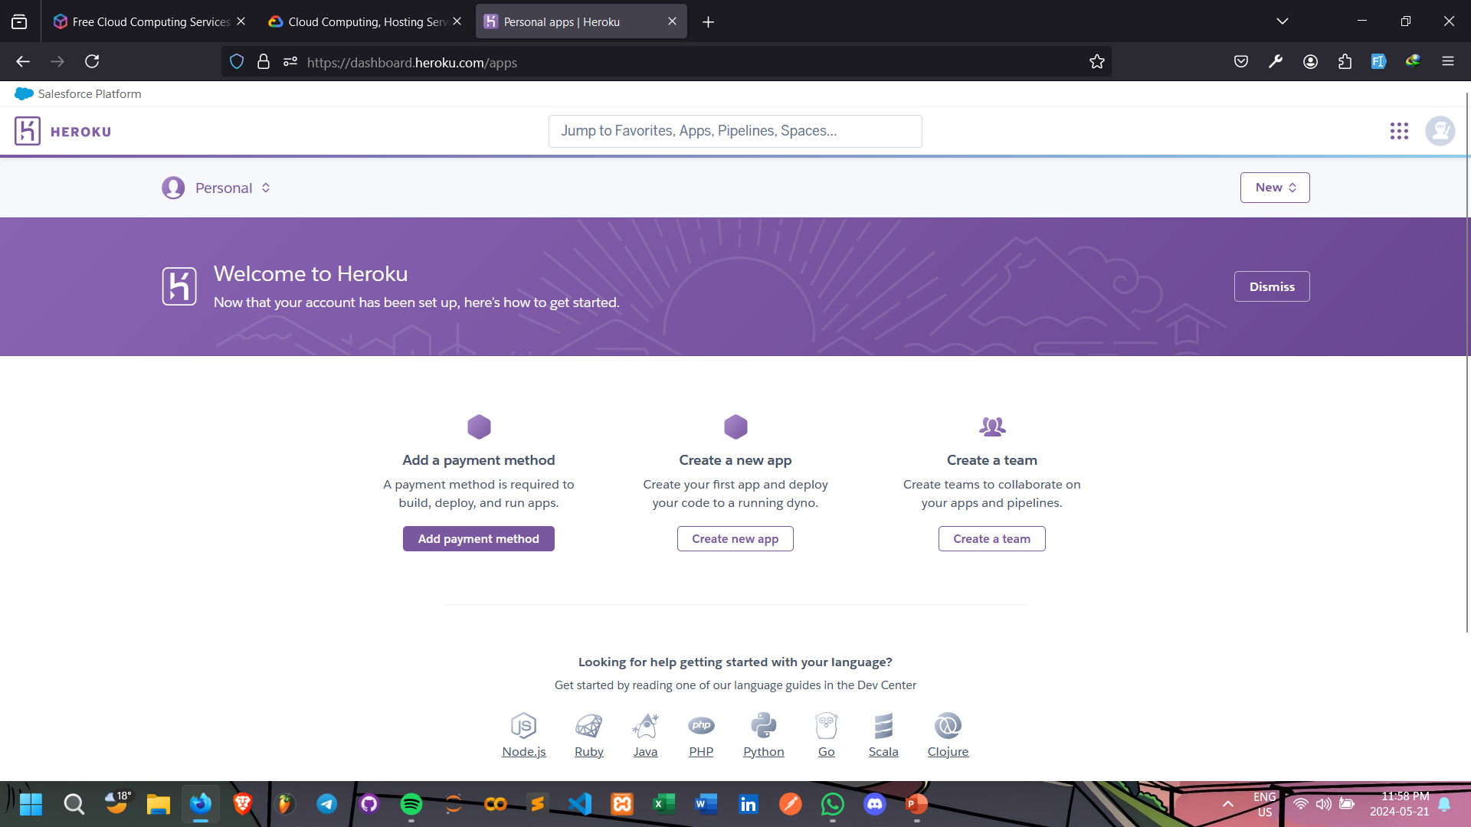
Heroku

Slide 16
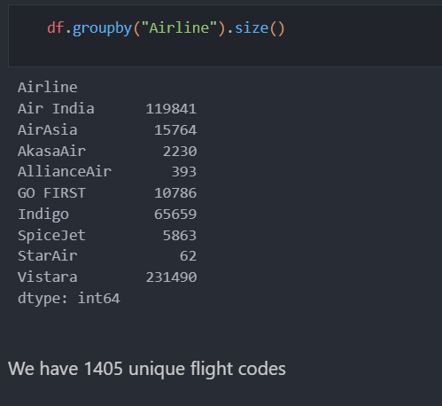
Total Airlines we have
We have 9 different airlines and we have 1405 unique flight codes.

Slide 17
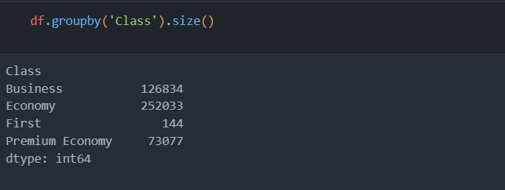
We have four different classes.

Slide 18

Let's Jump Into some fun part!

Slide 19
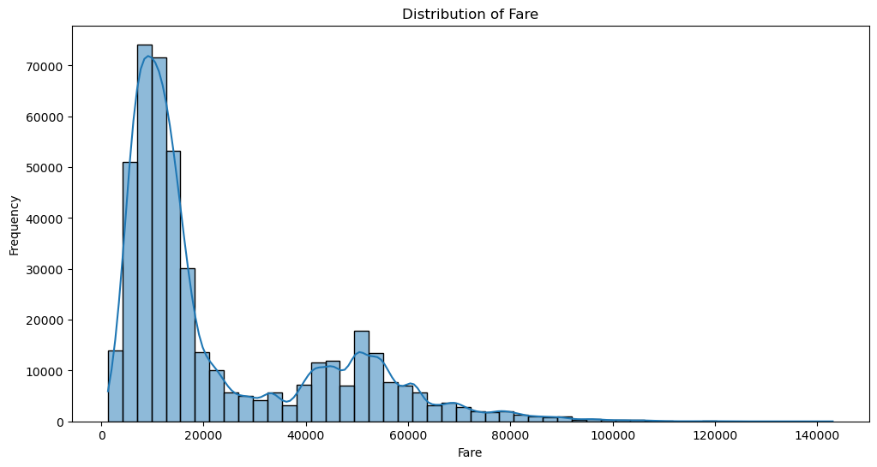
From the graph we notice that the fare distribution is right-skewed which shows that most fares have lower prices.

Slide 20
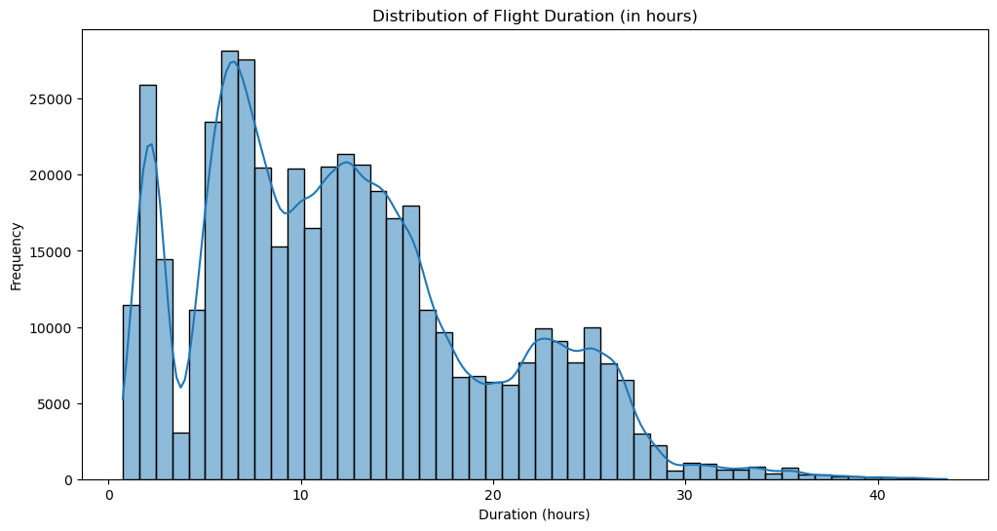
Distribution of flight Duration.

Slide 21
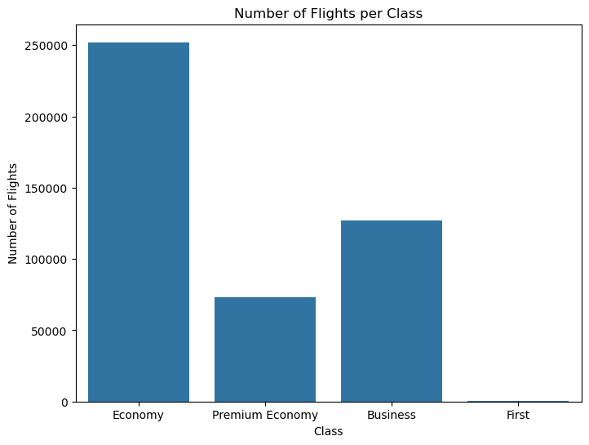
Economy is the most selected class.

Slide 22
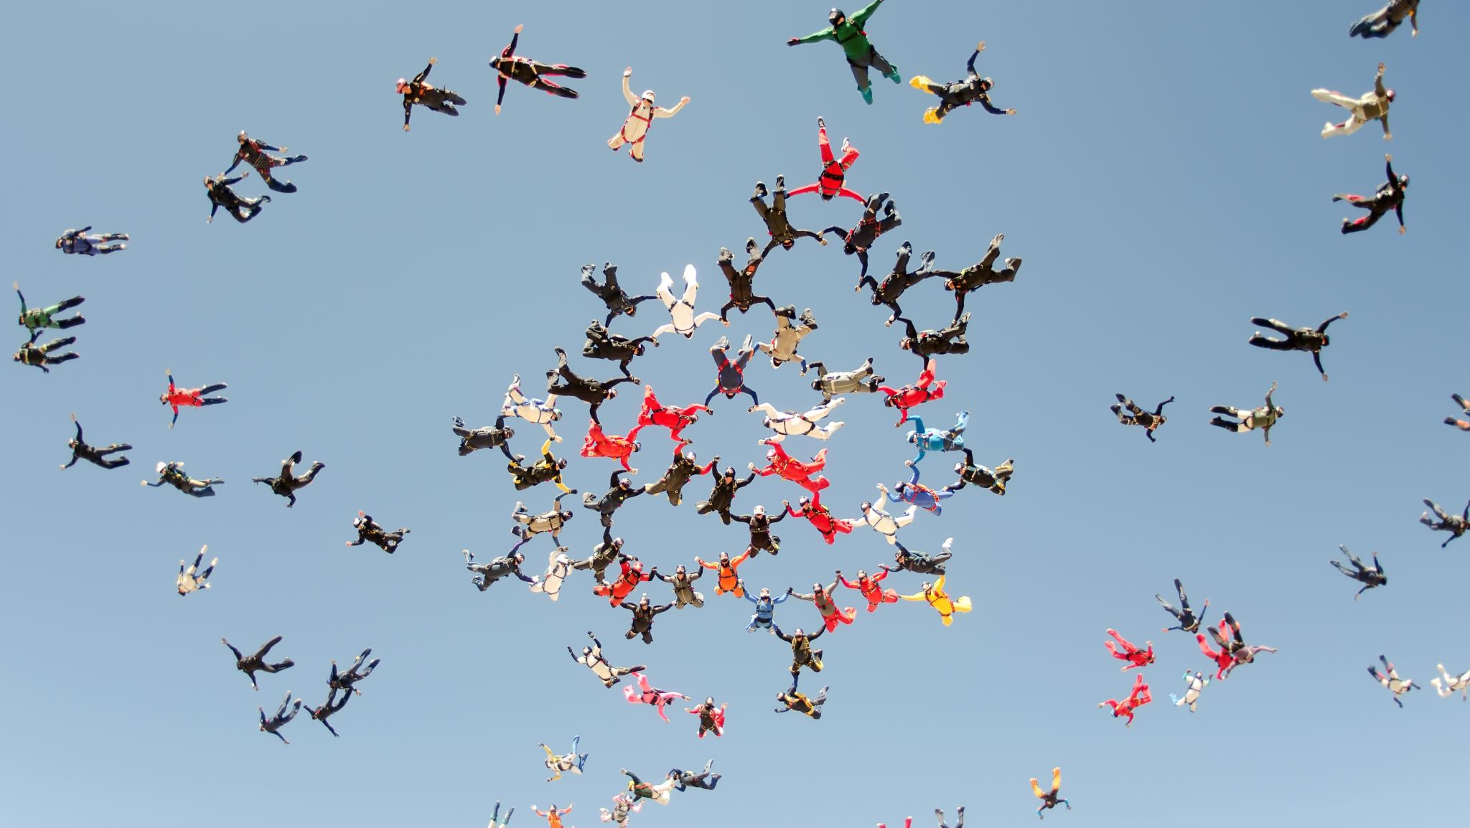
Thank You
We will keep developing for the best results.

Slide 23

ANY QUESTIONS ??

